Slide 1

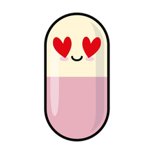
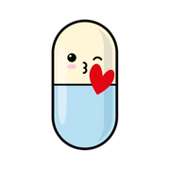
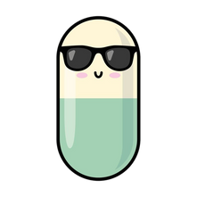
WHICH FACTORS CONTRIBUTE MOST TO USER SATISFACTION OF PHARMACEUTICAL DRUGS
Vrushali Patel
​
Vallesia Pierre Louis​
Ryan Chen

Slide 2
DATA DESCRIPTION AND MOTIVATION

Slide 3
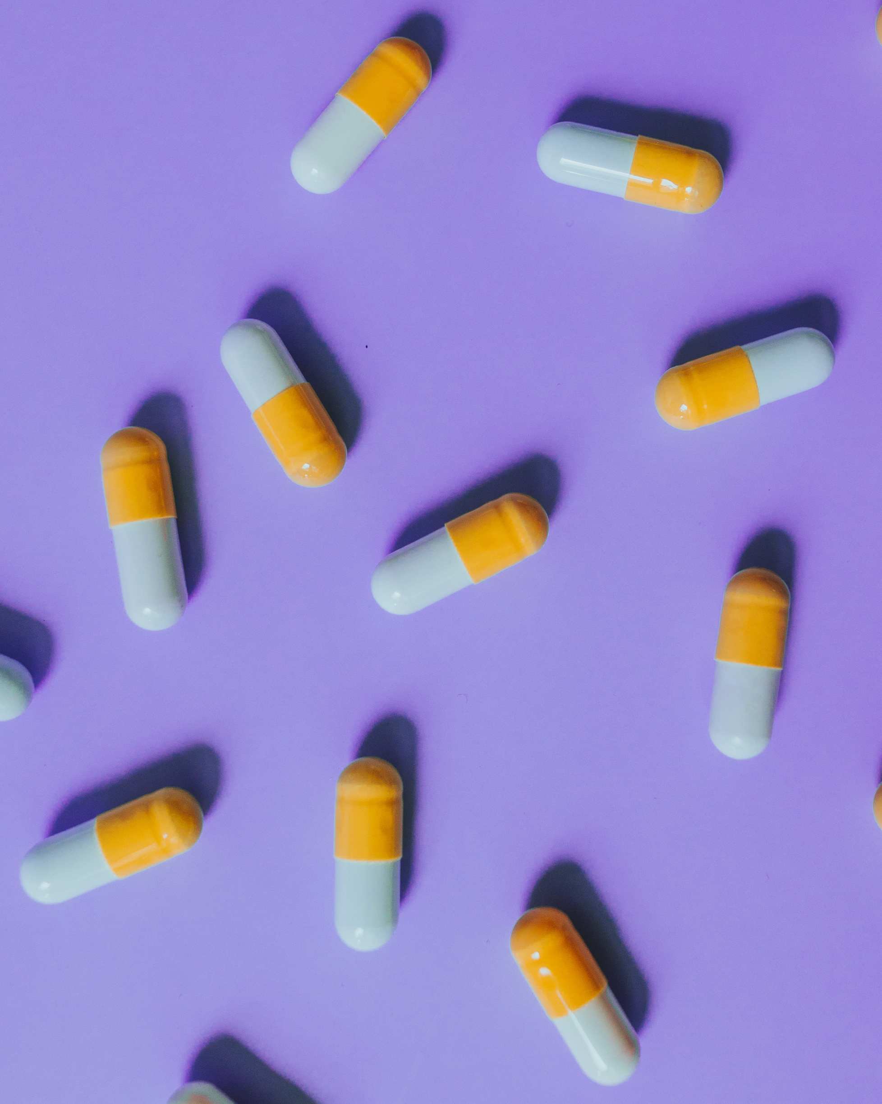
MOTIVATION
Motivation -Prescription and over the counter drug are used everyday, we hope to find out the factors related to medicine that contribute the most to user satisfaction as consumers

Slide 4
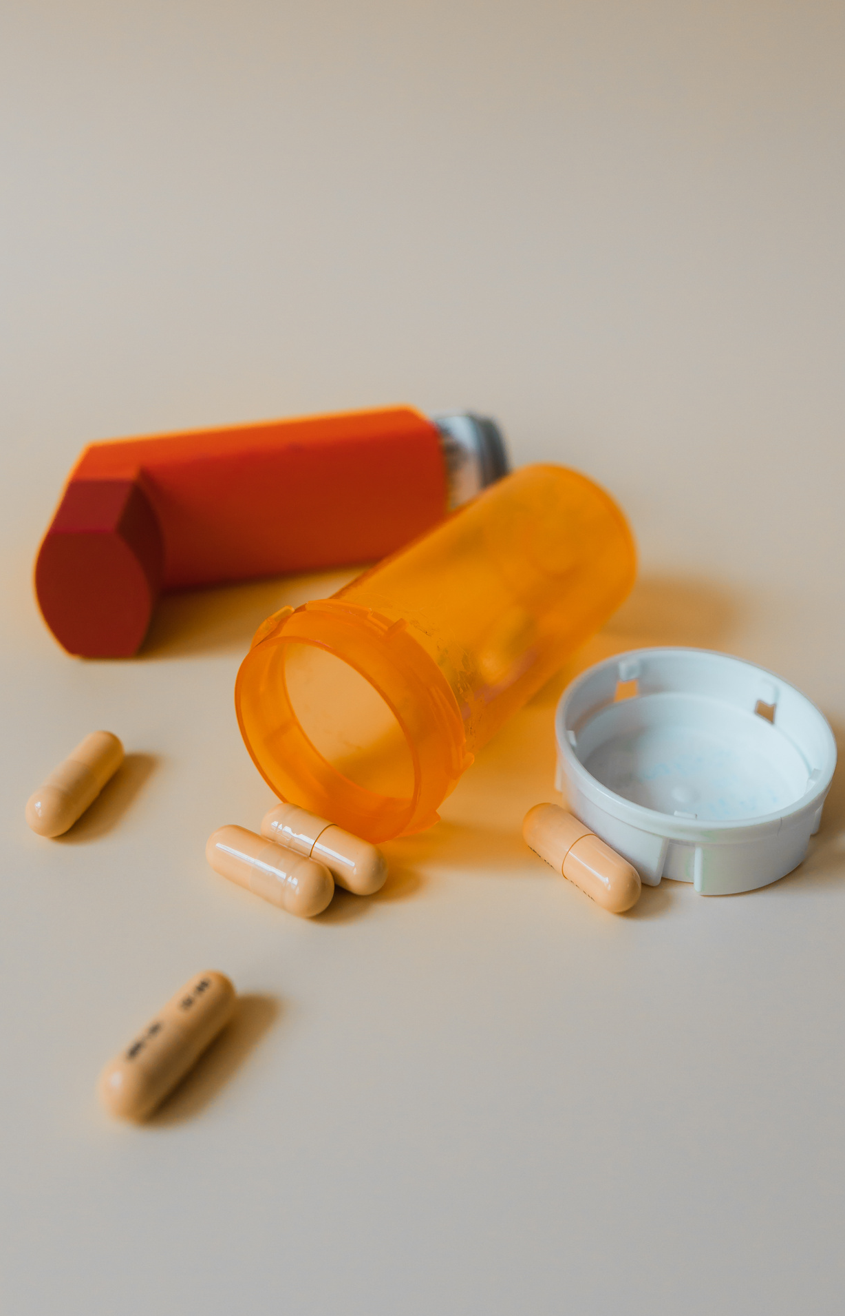
Dataset- Drug Performance Evaluation
The predictors of this dataset are the condition, the drug name , the ease of use, the effectiveness, form, indication, price, reviews, satisfaction, and type. ​
The data was collected through performance evaluation, on how different variables affect patient evaluation.
The diverse variables are a valuable tool for satisfaction.
DATA DESCRIPTION​

Slide 5
BASIC DATA ANALYSIS

Slide 6
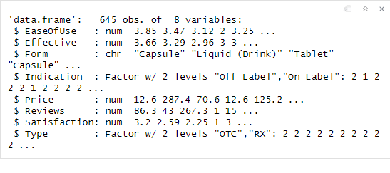
DATA CLEANING
The variables, Condition and Drug Name will be removed.
Omit missing values
Removed “other” from Indication and Type
Indication and Type were turned into dummy variables

Slide 7
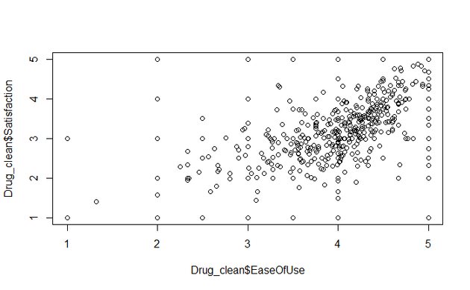
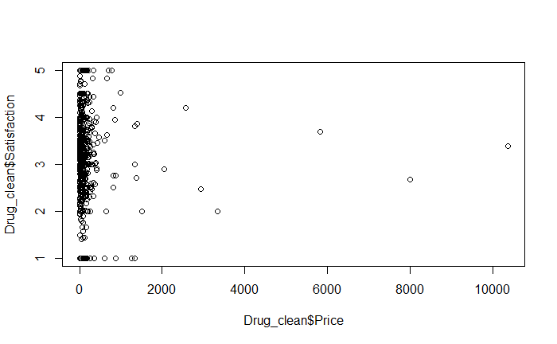
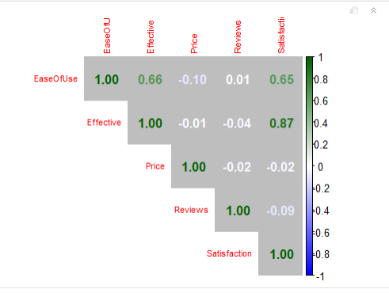
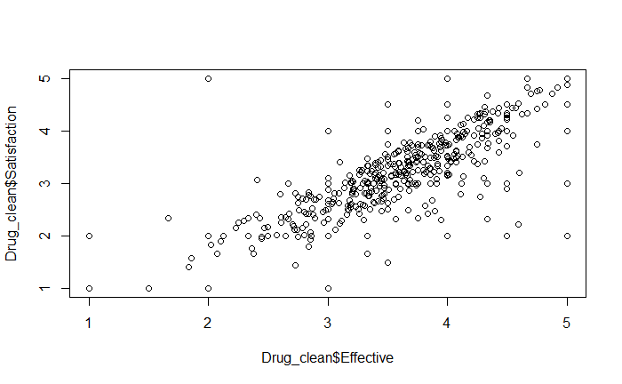
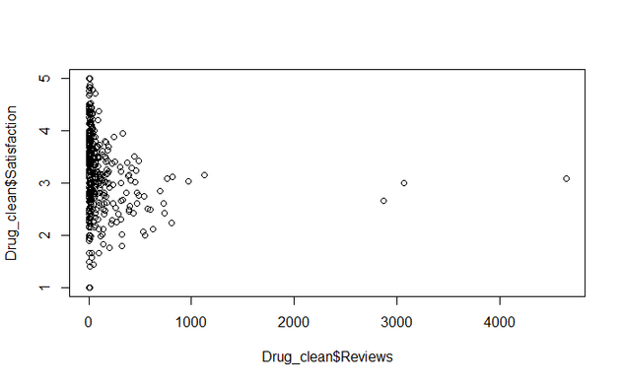
OUTLIERS
Correlation PLot

Slide 8
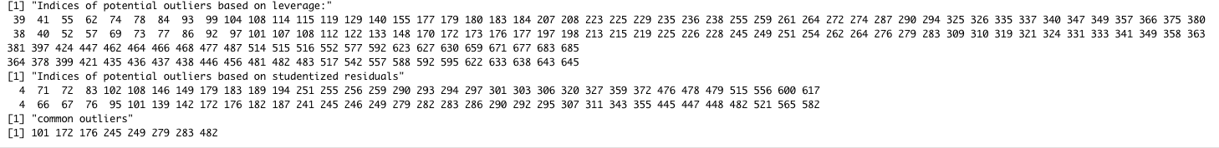
OUTLIERS (PART 2)
All cook’s Distance values were below 1
Jackknife value is 1.963707
Leverage threshold: 0.02790698 with 74 outliers
studentized residuals have 34 outliers
8 in common

Slide 9
MODEL DIAGNOSTIC

Slide 10
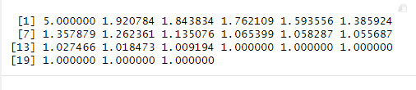
Collinearity
All VIF values below 10

Slide 11
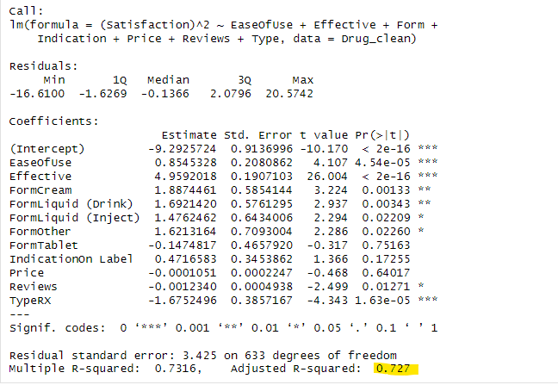
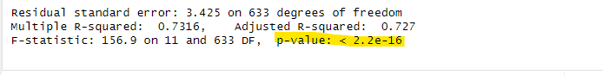
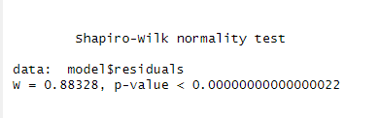
NORMALITY
After Shapiro Test, we decided to transform our model, but our data did not improve enough to justify it.

Slide 12
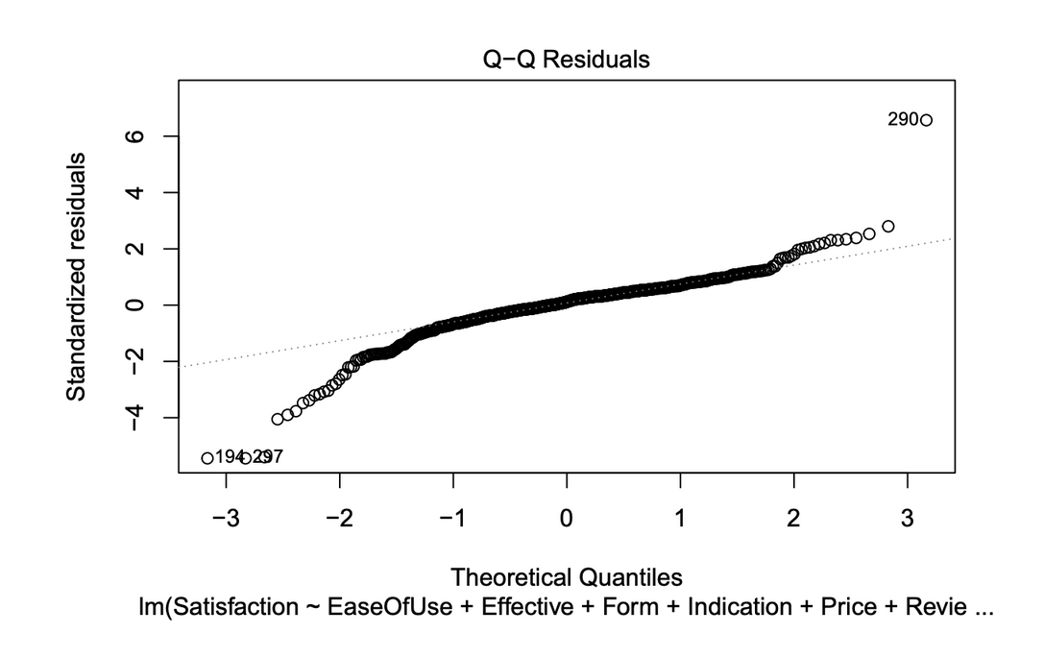
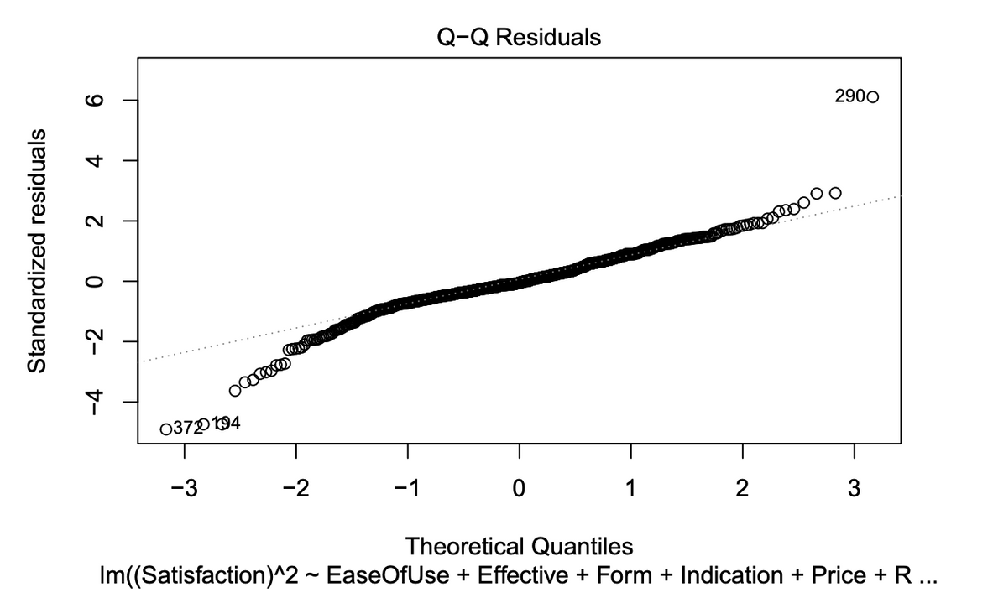
Normality
Transformed

Slide 13
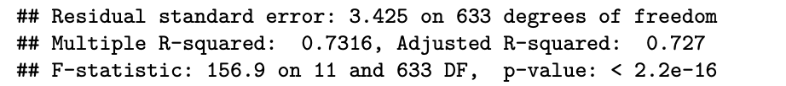
MODEL SELECTION
Decided to use Backwards elimination because of our F-statistic and P-Value.

Slide 14
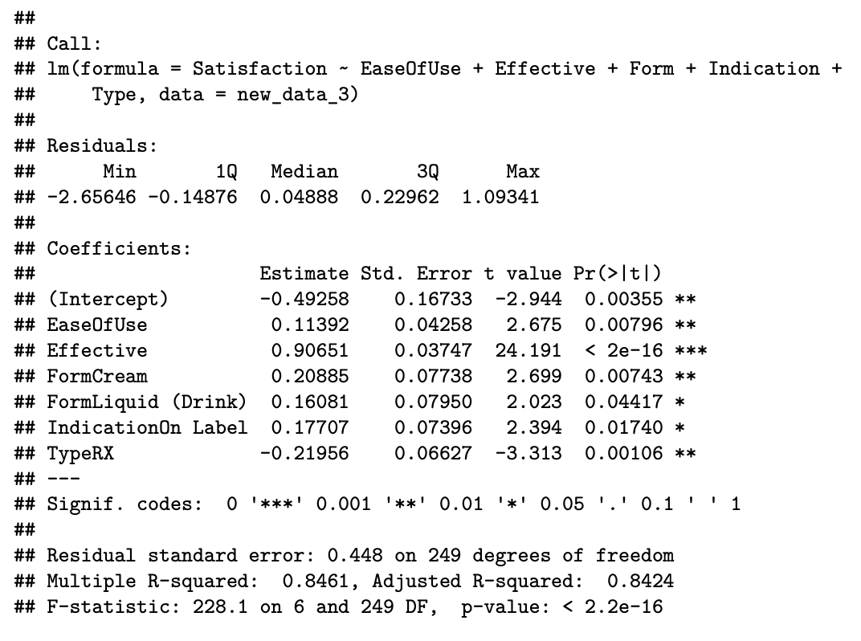
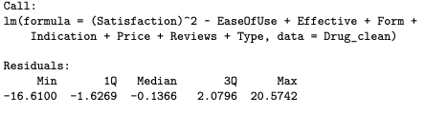
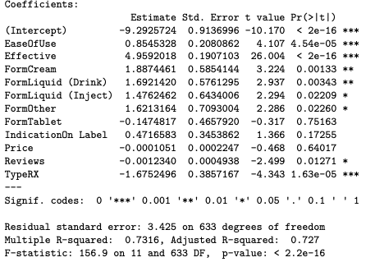
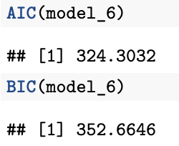
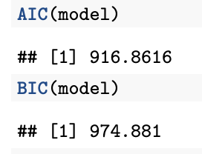
Model Selection
Variables removed:
FormLiquid(Inject), FormOther
FormTablet, Price, Reviews

Slide 15

PRELIMINARY RESULTS
Backwards Elimination
Using backwards elimination a final model we selected consist of 6 predictors: EaseOfUse, Effective,FormCream,Form Liquid(Drink),Indication(On Label),Type(RX)
Potential Outliers
No major outliers from cooks distance, the ones from Jackknife and leverage we deemed to be feasible and decided not to remove them
84 % of the customer’s satisfaction is accounted for by Ease OfUse, Effectiveness, Form, Indication and Type.
No collinearity
All VIF values < 10.
Final Model
From our model we can say that the EaseOfUse, Effectiveness, Form(cream and liquid), Indication(on Label), Type(Rx) factors that contribute most to user satisfaction of pharmaceutical drugs

Slide 16
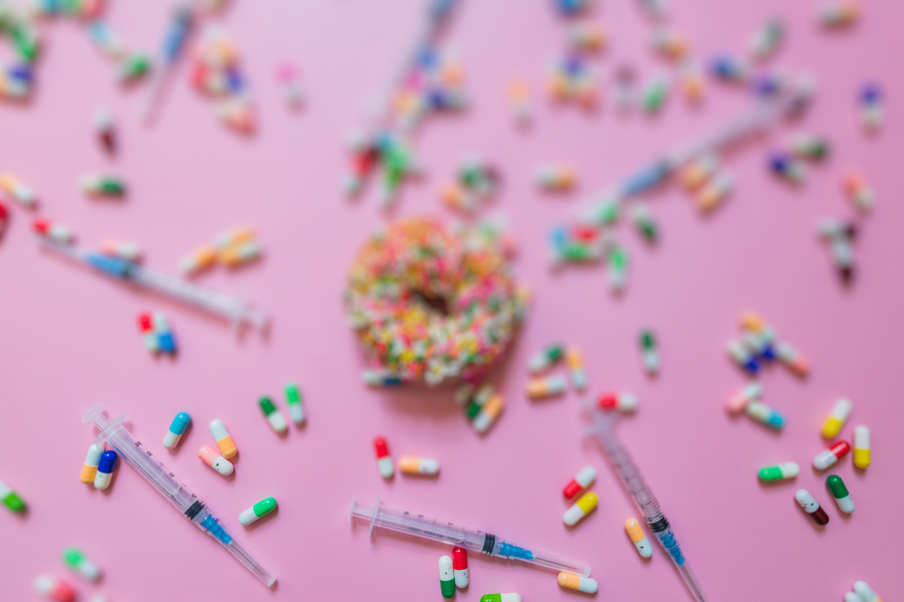
FINAL MODEL
Satisfaction = -049258 + 0.11392(EaseOfUse) +0.90651(Effective) + 0.20885 (FormCream) + 0.16081(FormLiquid (Drink)) + 0.17707 (IndicationOn Label) - 0.21956(TypeRX)

Slide 17
DIFFICULTY ENCOUNTERS​
Normality violation want to look back and try to find a solution
Rcode was having issues maybe due to operating system between us

Slide 18

























RESOURCES
HIsch, Irl. “Insulin Pricing in the USA: The Saga Continues.” The Lancet, www.thelancet.com/journals/landia/article/PIIS2213-8587(22)00251-0/fulltext
“Most Expensive Drugs in the US in 2023.” Fierce Pharma, www.fiercepharma.com/special-reports/priciest-drugs-2023.
https://www.kaggle.com/datasets/thedevastator/drug-performance-evaluation

